Slide 1
Consumer Behavior Analytics
Francis Troy Kirinhakone
Carlos He He

Slide 2
Goal and Mindset
Understand e-commerce consumer behavior
Perform EDA
Utilize machine learning

Slide 3

Dataset
Brazilian E-commerce Public Dataset by Olist
Contains over 100,000 orders with customer, order, product info and more.

Slide 4
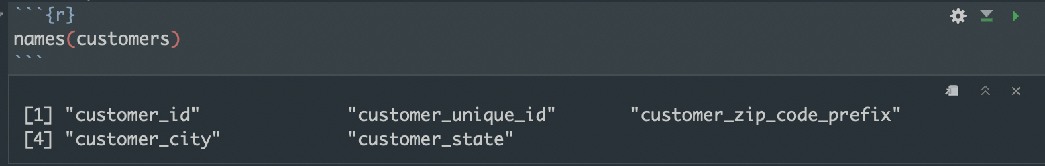
Dataset

Slide 5
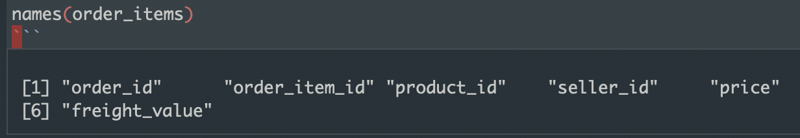
Dataset

Slide 6
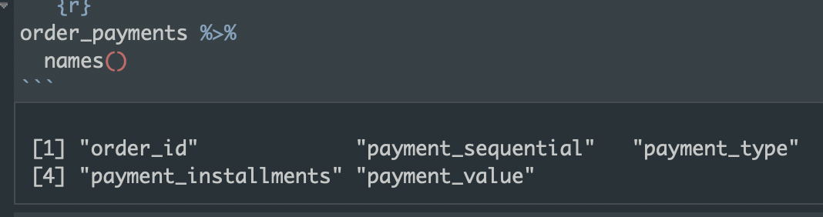
Dataset

Slide 7
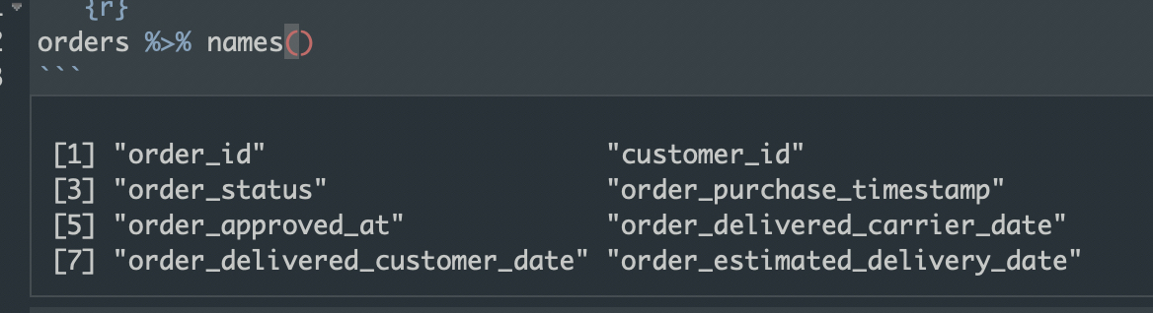
Dataset

Slide 8
Dataset
Notes:
Given a rich dataset

Slide 9
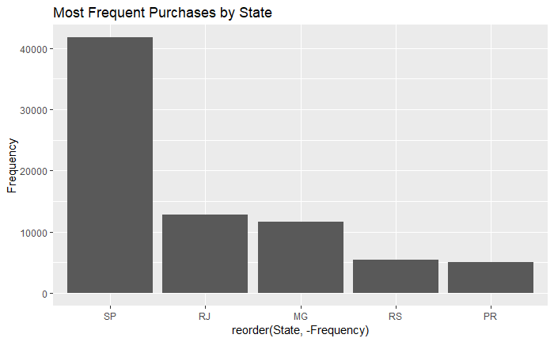
Exploratory Data Analysis
Notes:
Given a rich dataset

Slide 10
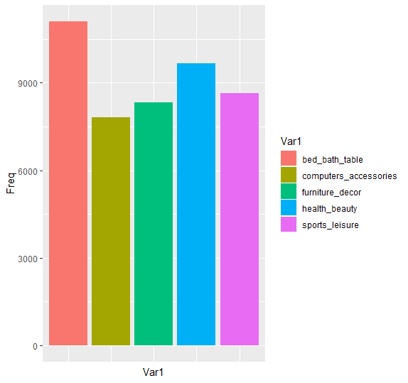
Exploratory Data Analysis
Notes:
Given a rich dataset

Slide 11
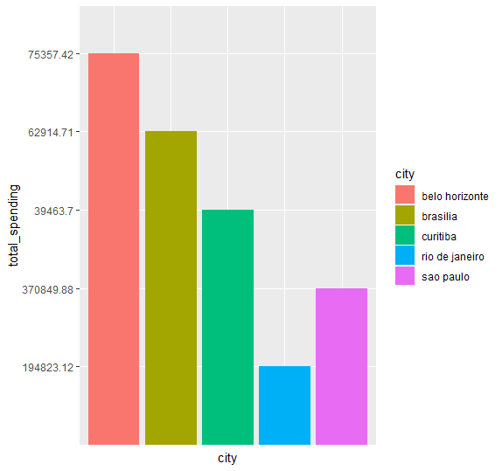
Exploratory Data Analysis
Notes:
Given a rich dataset

Slide 12
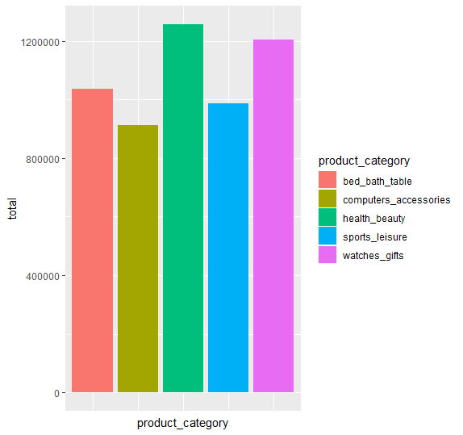
Exploratory Data Analysis
Notes:
Given a rich dataset

Slide 13
Exploratory Data Analysis
Now what
Notes:
Given a rich dataset

Slide 14
Linear Regression
Notes:
Given a rich dataset

Slide 15
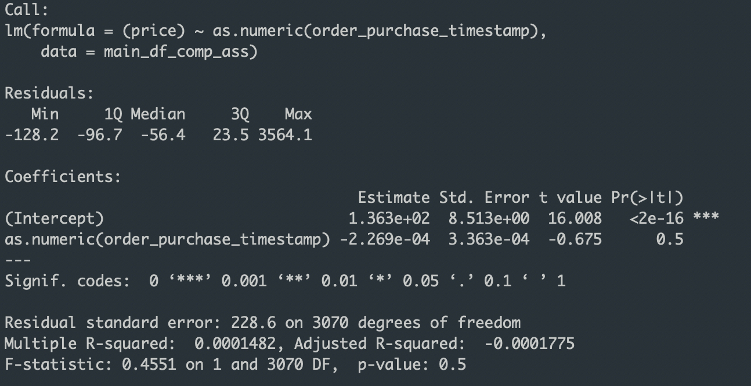
Linear Regression
Notes:
Given a rich dataset

Slide 16
Linear Regression
Notes:
Given a rich dataset

Slide 17
Logistic Regression
Notes:
Given a rich dataset

Slide 18
Logistic Regression
Notes:
Given a rich dataset

Slide 19
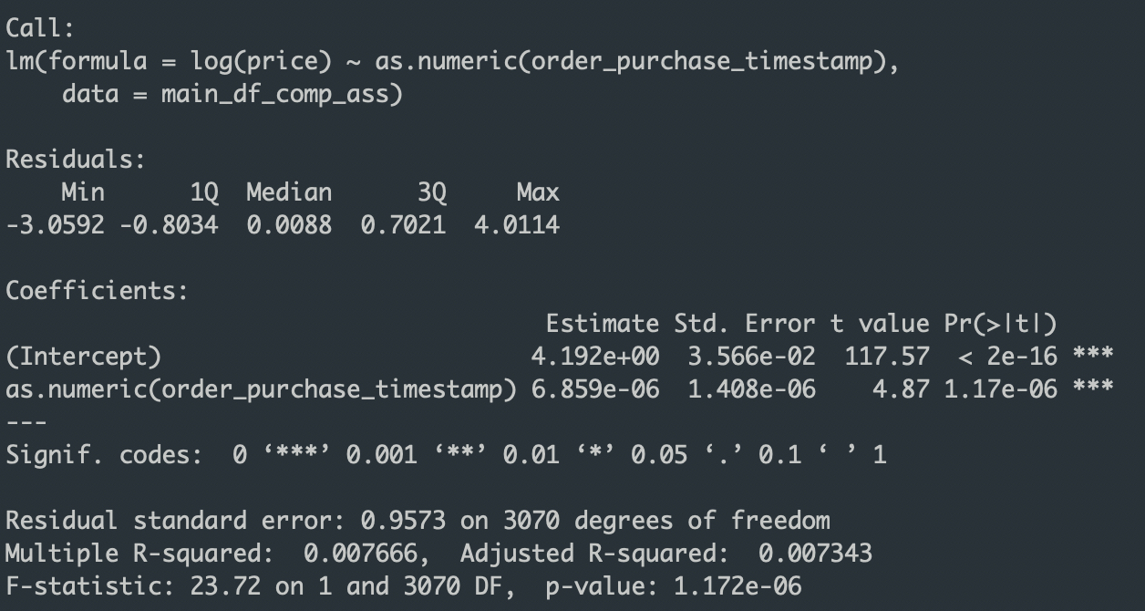
Logistic Regression
Notes:
Given a rich dataset

Slide 20
…
What now?
Notes:
Given a rich dataset

Slide 21
Logistic Regression
Notes:
Given a rich dataset

Slide 22
Prospective Uses
Small Business
Notes:
Given a rich dataset

Slide 23
Prospective Uses
Small Business
Marketing Agencies
Notes:
Given a rich dataset

Slide 24
Prospective Uses
Small Business
Marketing Agencies
Startups
Notes:
Given a rich dataset

Slide 25
Future Work
Marketing Dataset
Notes:
Given a rich dataset

Slide 26
Future Work
Marketing Dataset
Delivery Optimization
Notes:
Given a rich dataset

Slide 27
Future Work
Marketing Dataset
Delivery Optimization
Much more
Notes:
Given a rich dataset

